Slide 1
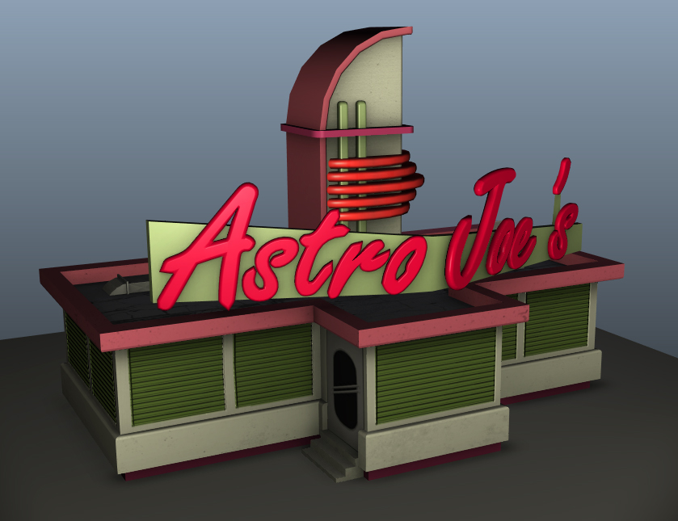
Class V Class 2-Week Game Jam
ADVANCED DIPLOMA OF GAMES TEACH-OUT
13 Students
2 Weeks
20 Unique 3D assets
25 Scripts
2052 Lines of code
5 Unique particle effects
12 Unique sounds effects

Slide 2
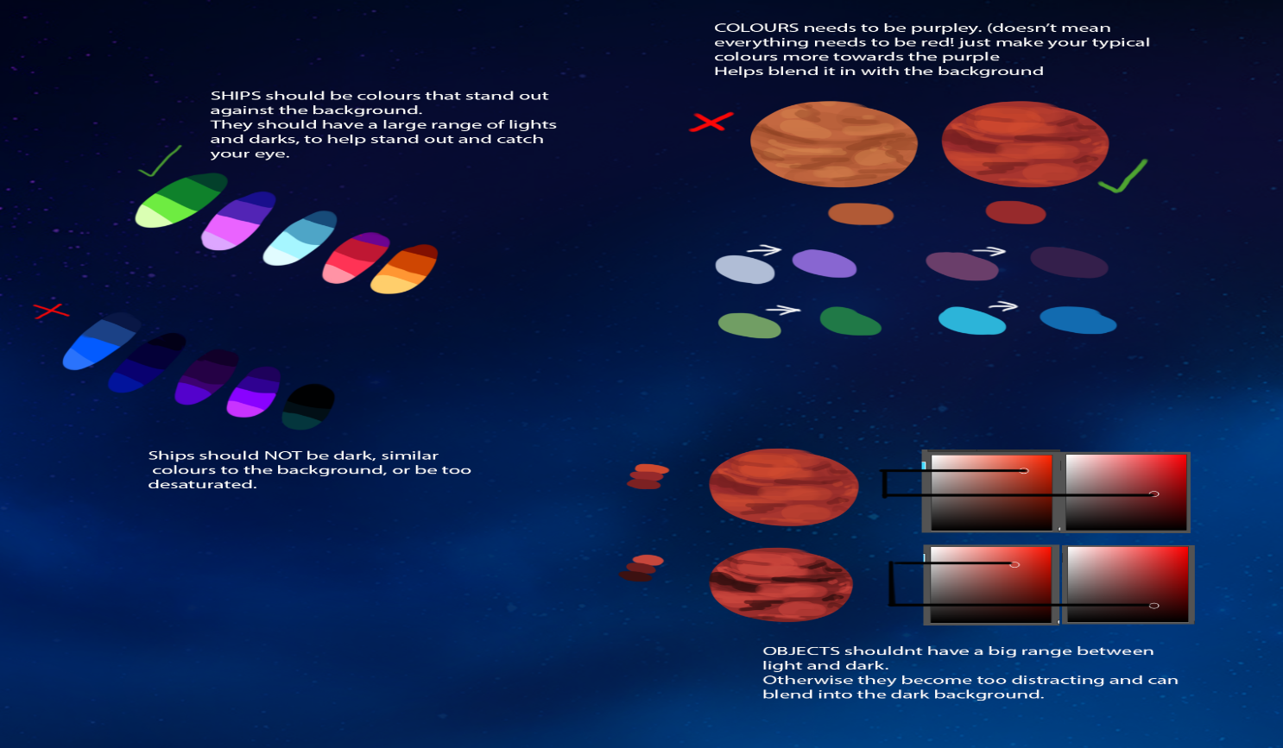
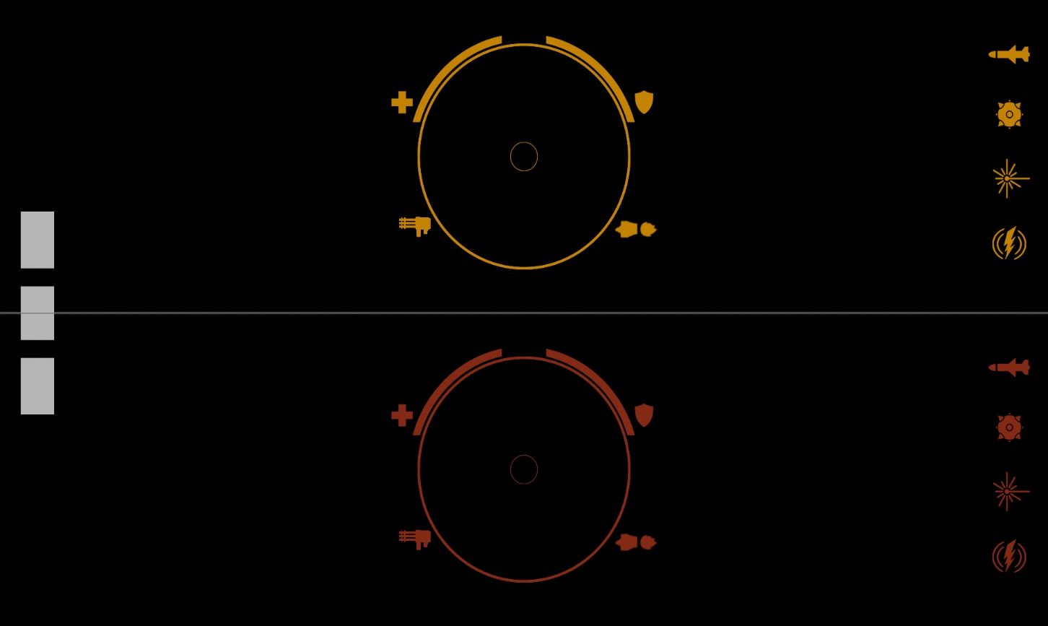
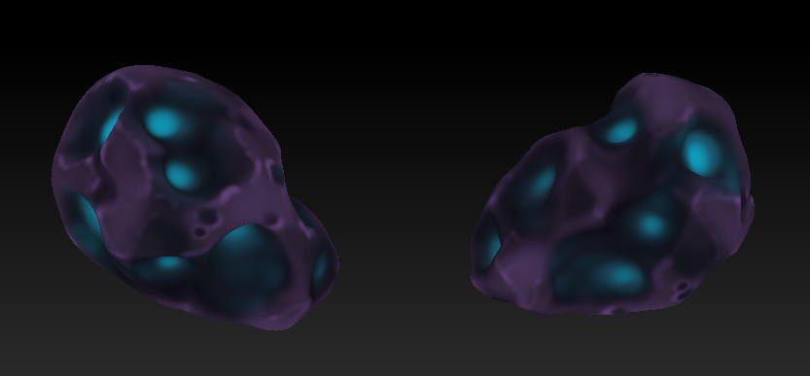
Day 1
After organising ourselves into teams and deciding team leaders the first priorities were:
1: Write up an initial design document laying out the basic gameplay ideas
2: Set an art style and decide on a colour pallet for the game to conform to
3: Get place holder and stand in assets done in order to begin producing playable builds ASAP
4: Get first draft of HUD as well as GUI and menu trees complete

Slide 3
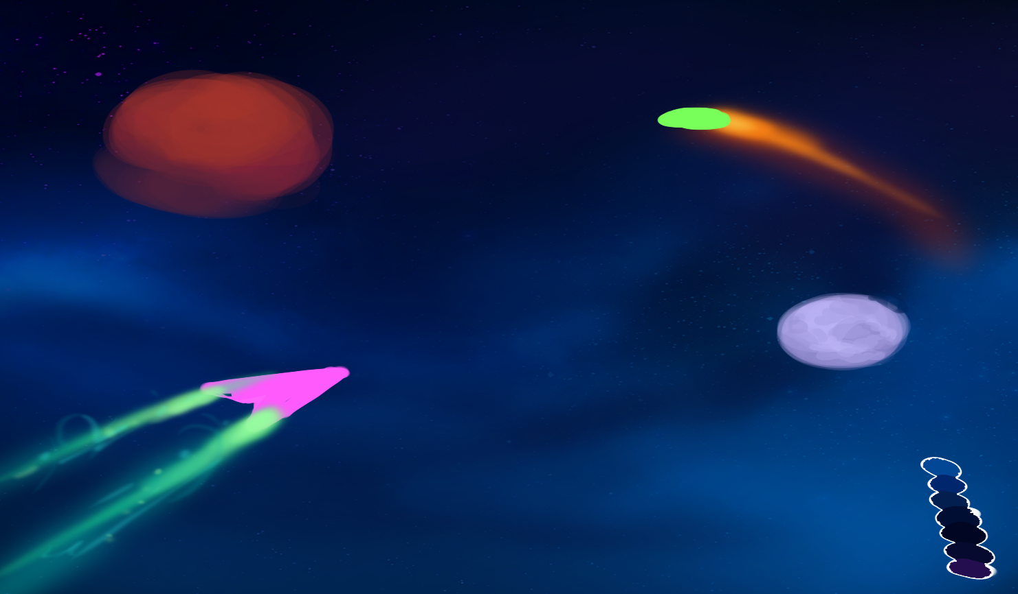
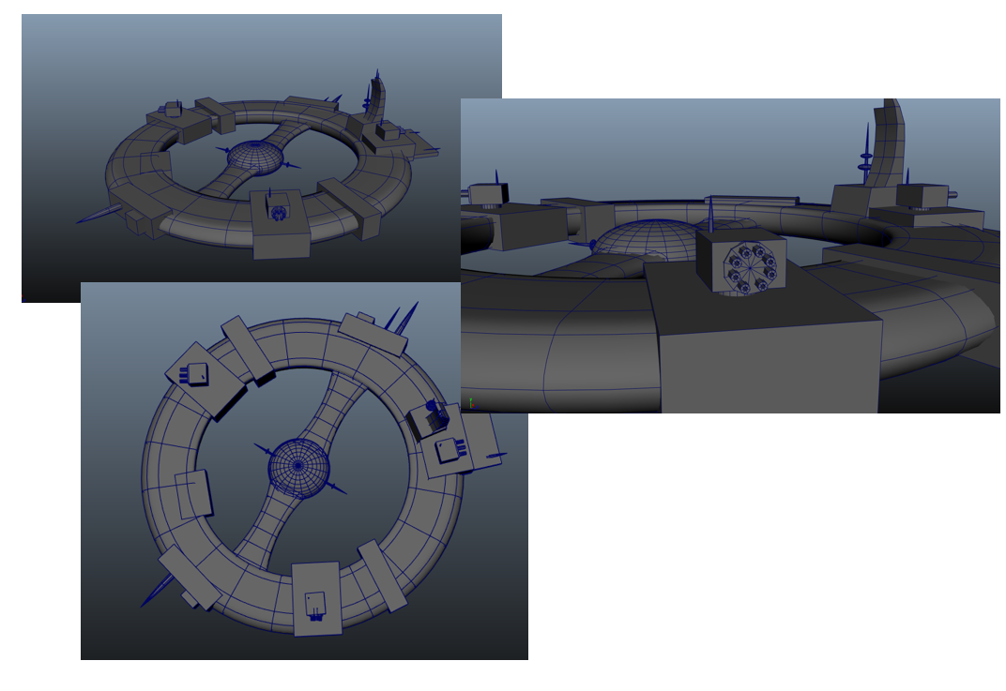
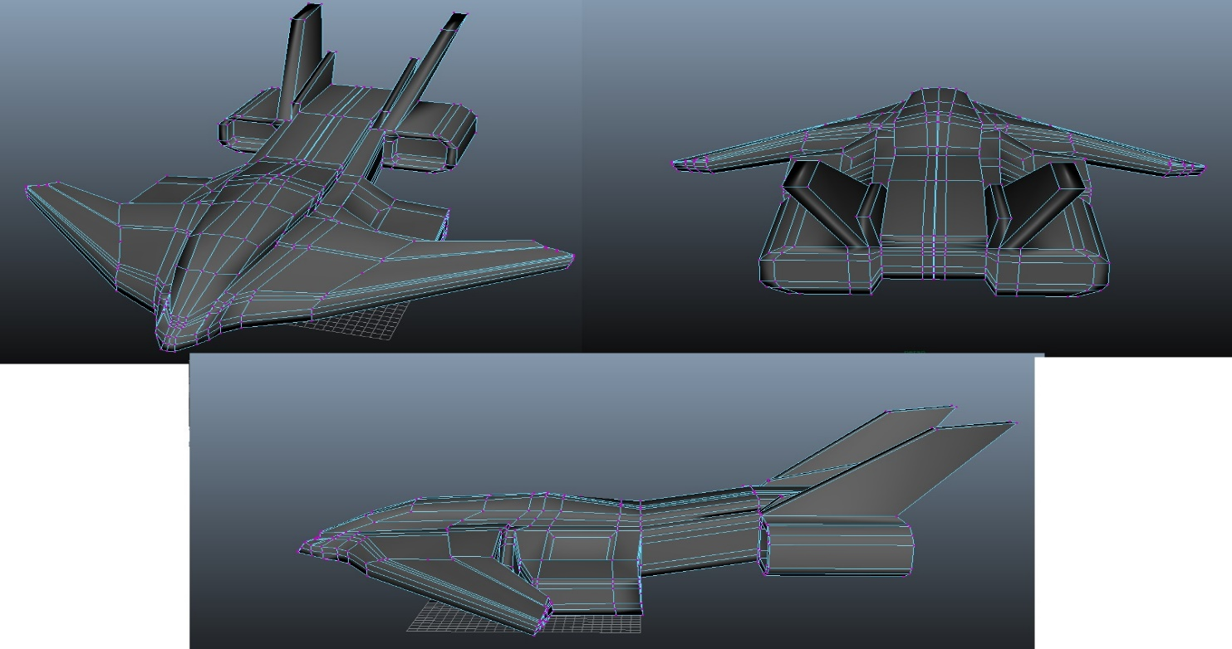
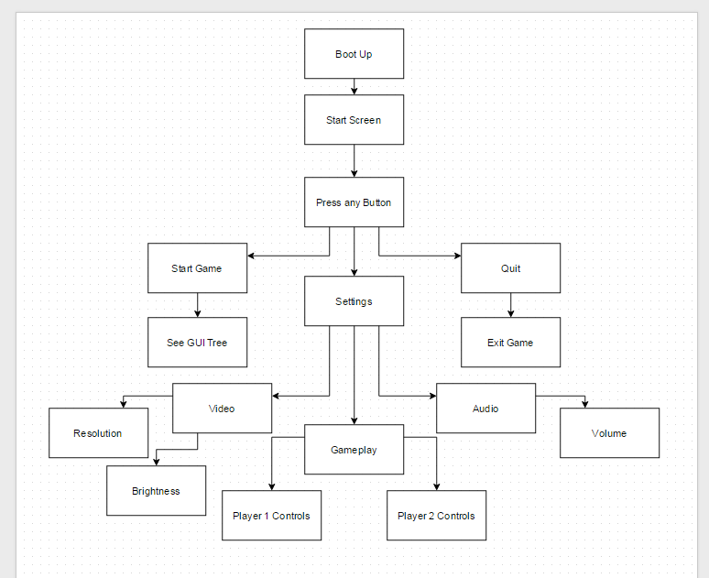

Slide 4
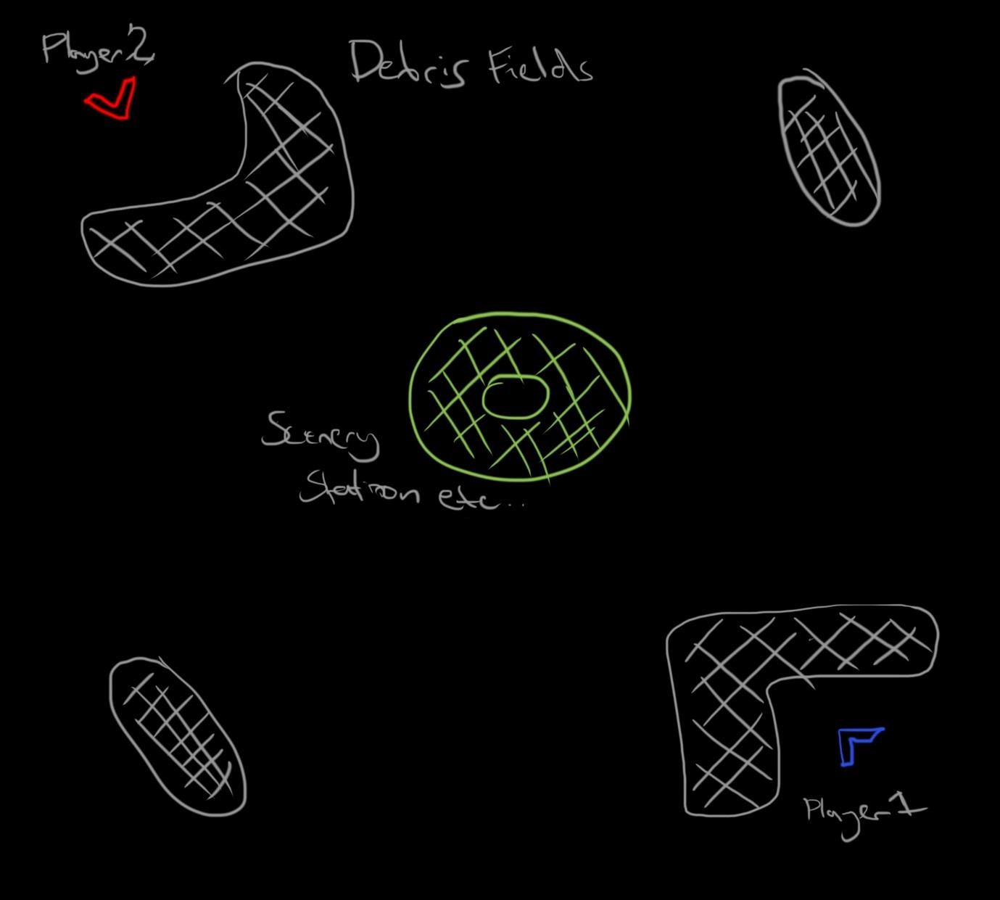
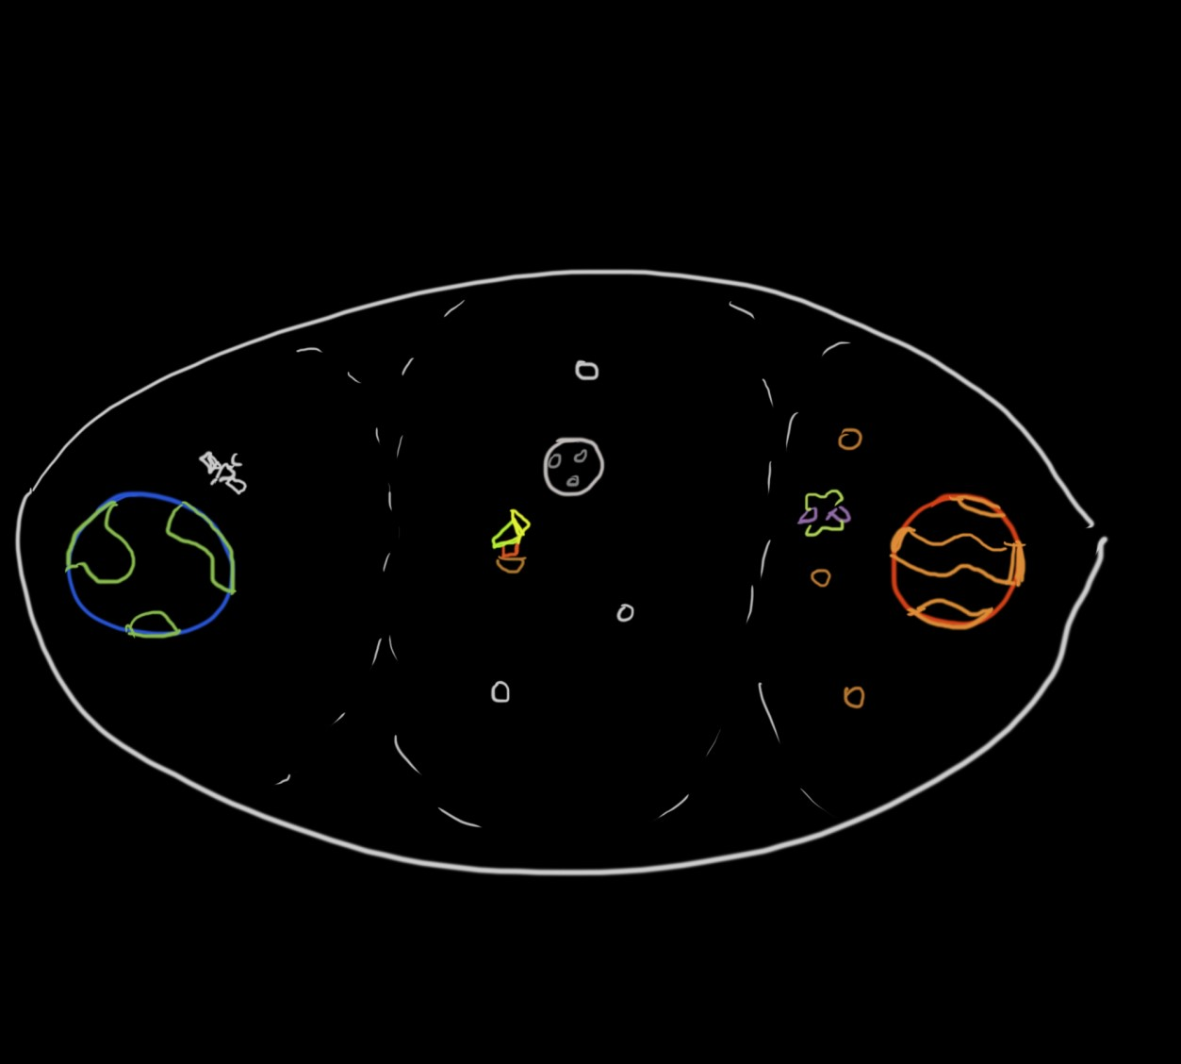

Slide 5
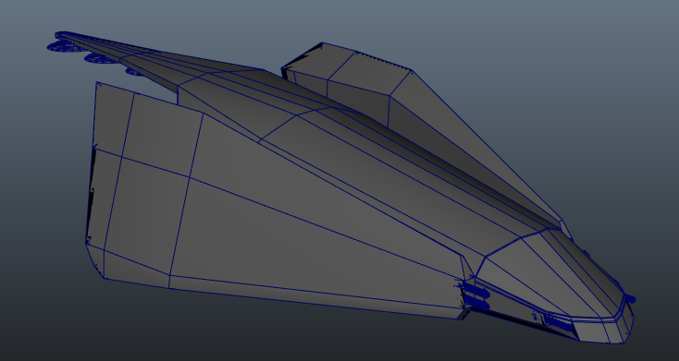
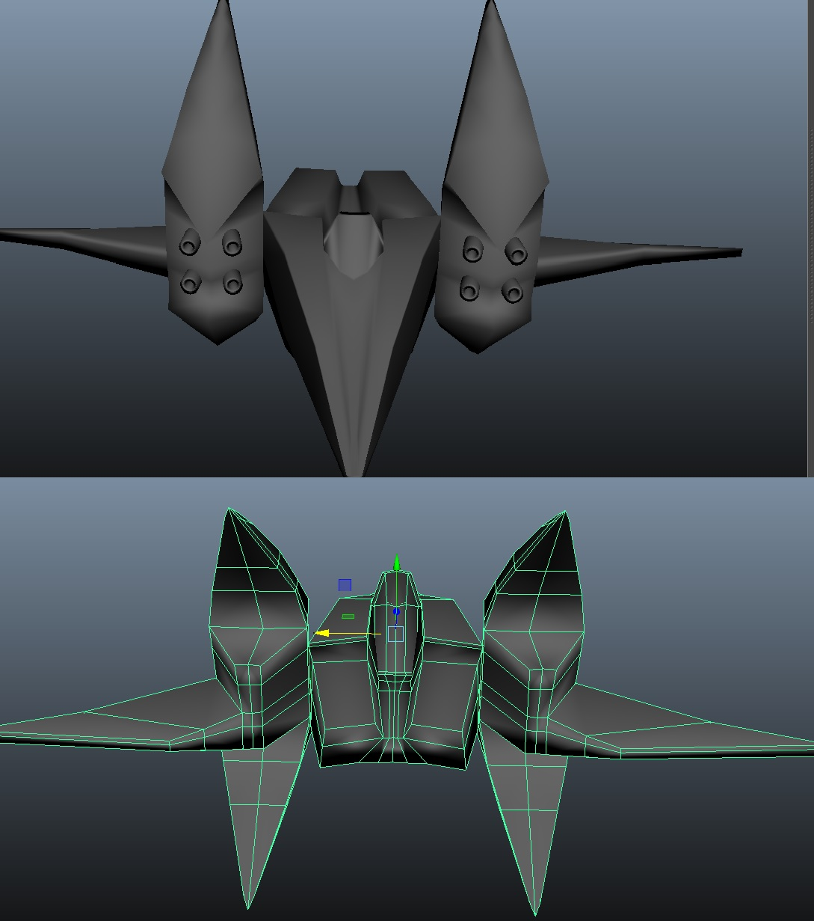
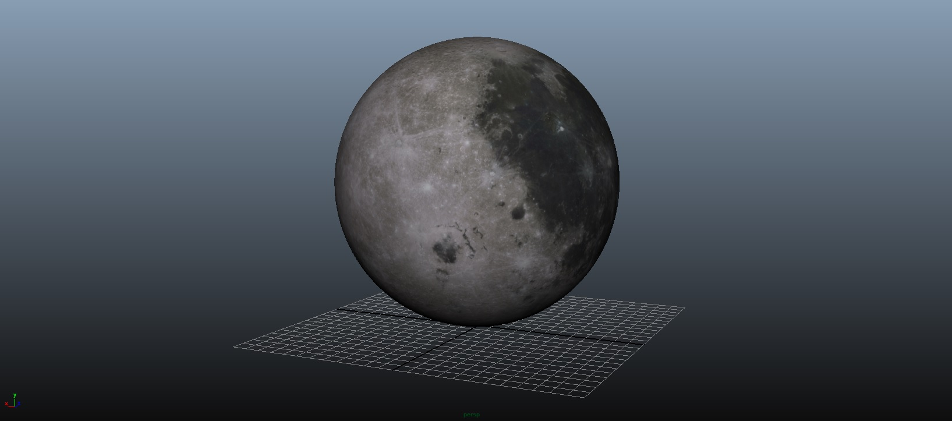

Slide 6
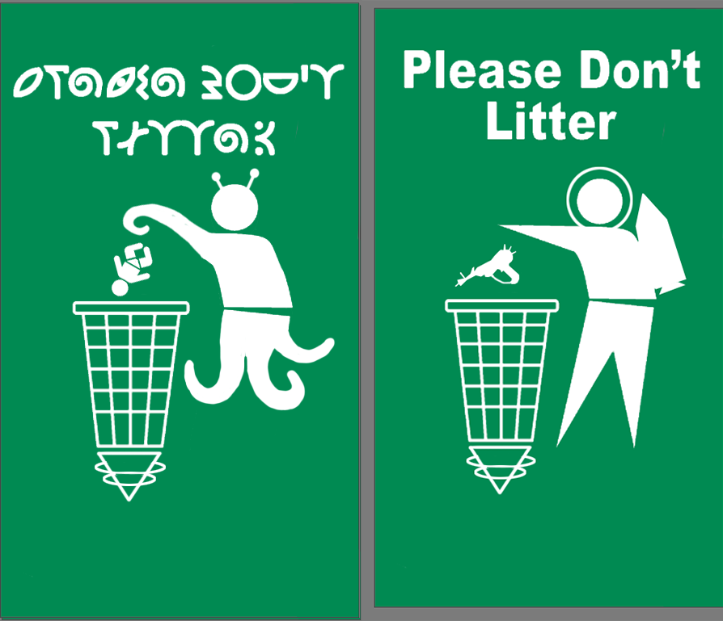
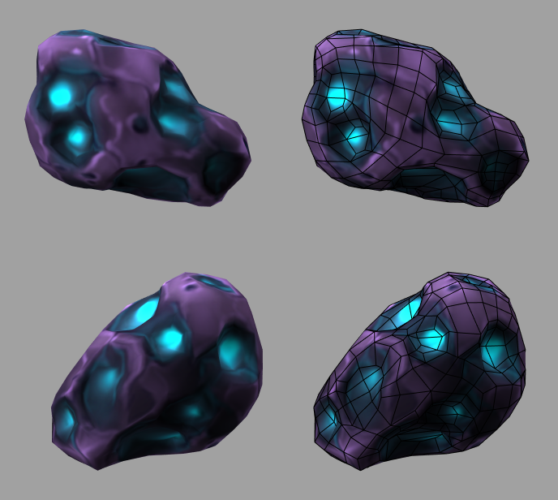
Day 2
After getting a better idea of the art style and gameplay ideas on Day 1 we further refined our design document, updating it to better represent the game we were making. Day 2’s priorities were:
1: Update design document
2: Establish working split-screen prototype
3: Unwrap and Texture certain assets
4: Code the player health and rocket fire ability
5: Update the HUD design
6: Pre-Alpha play test to gather feedback on the movement system

Slide 7
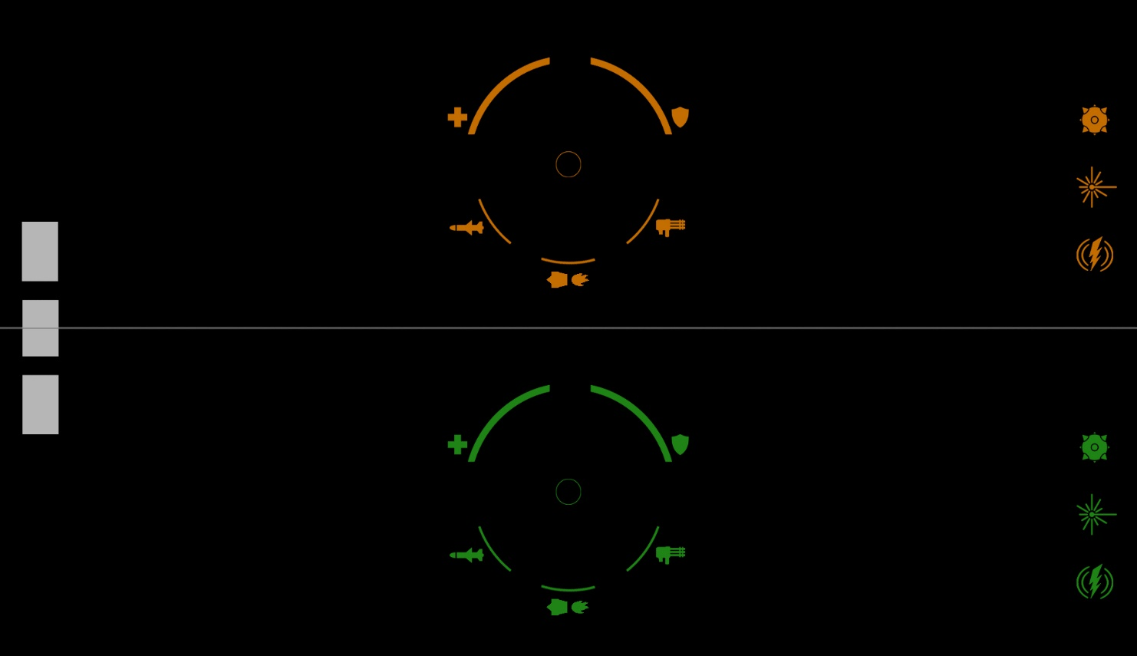
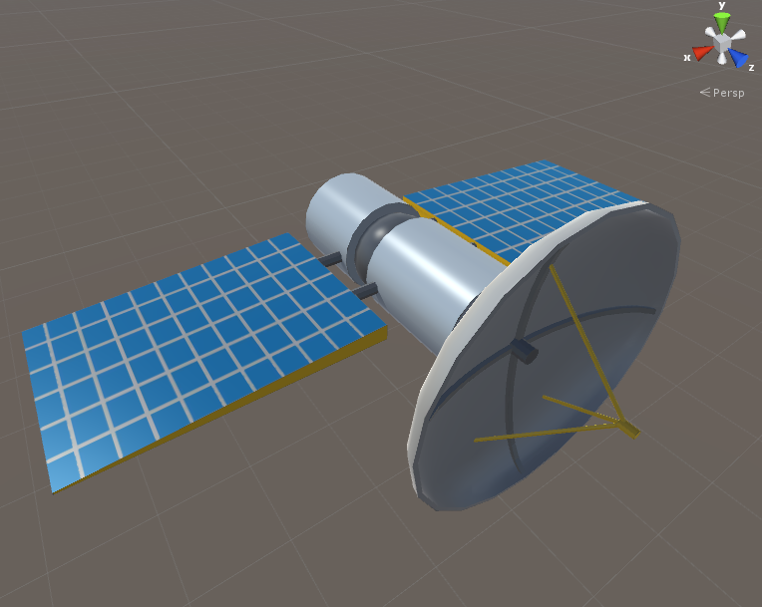
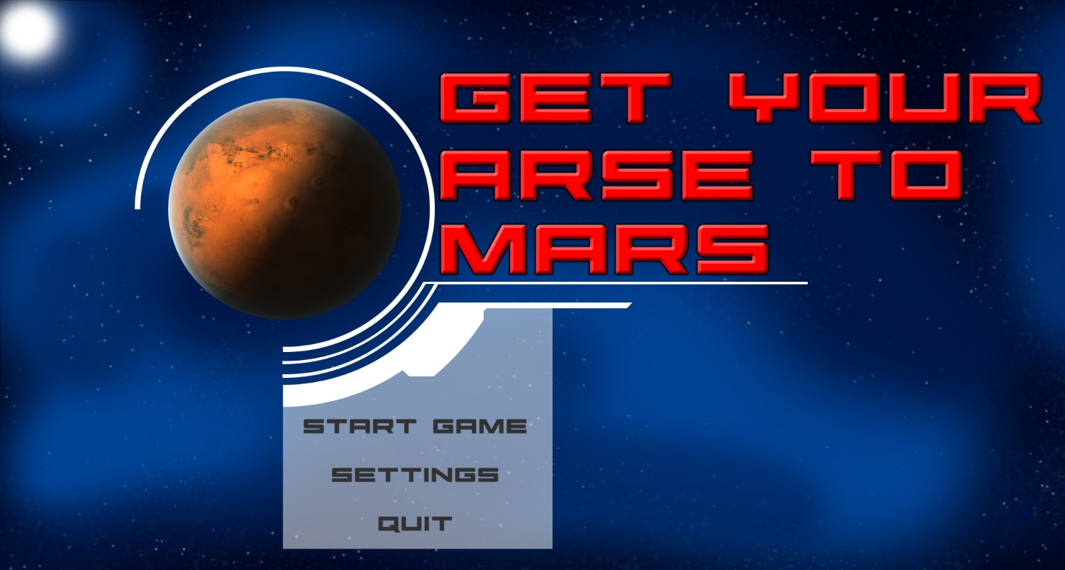
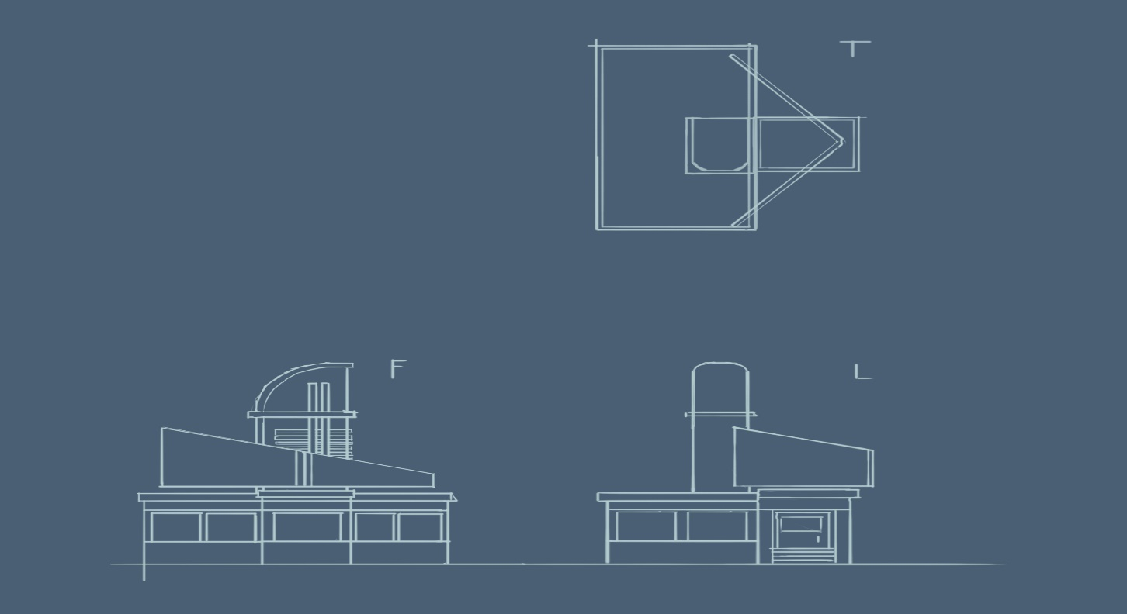

Slide 8
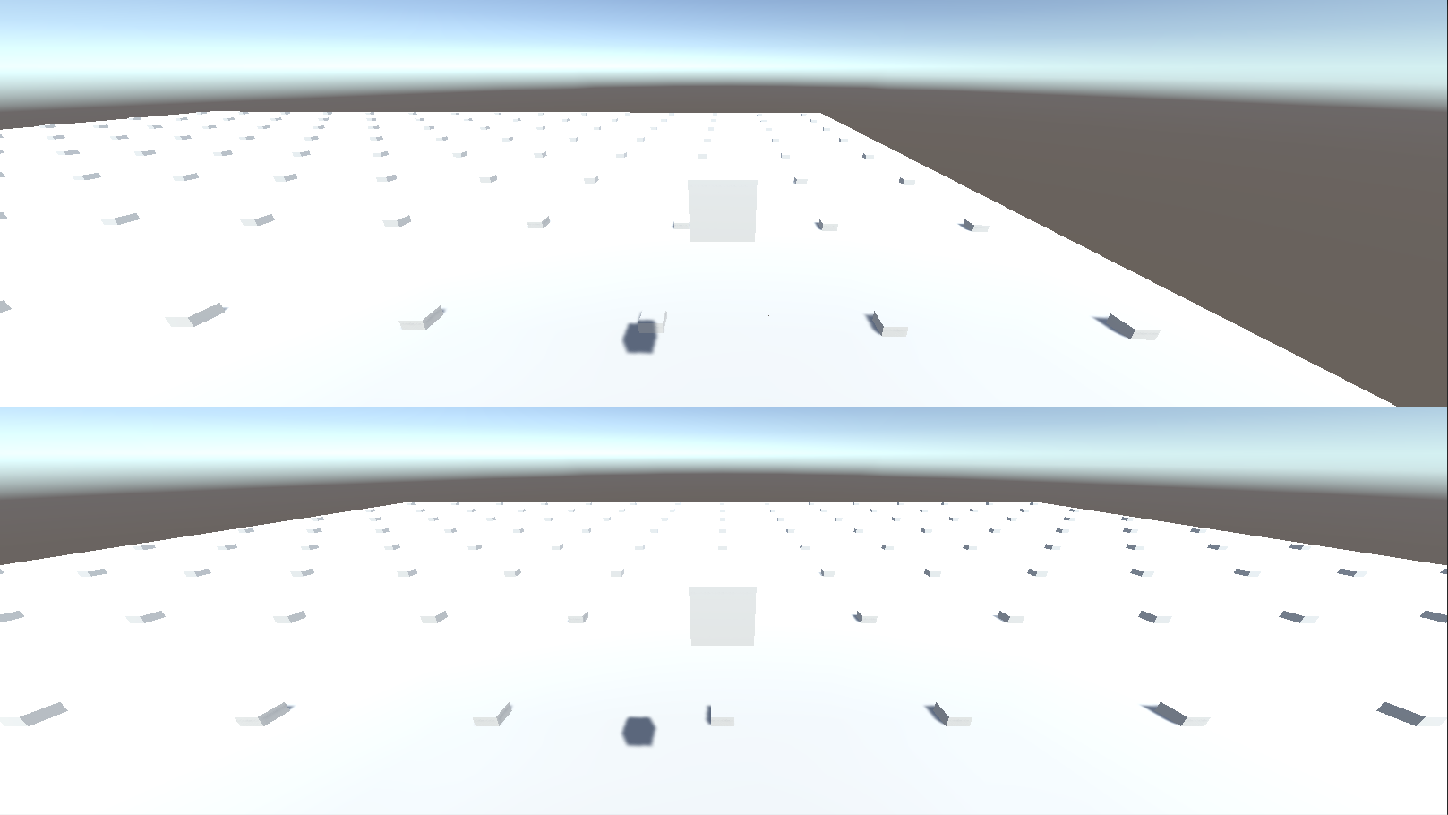

Slide 9
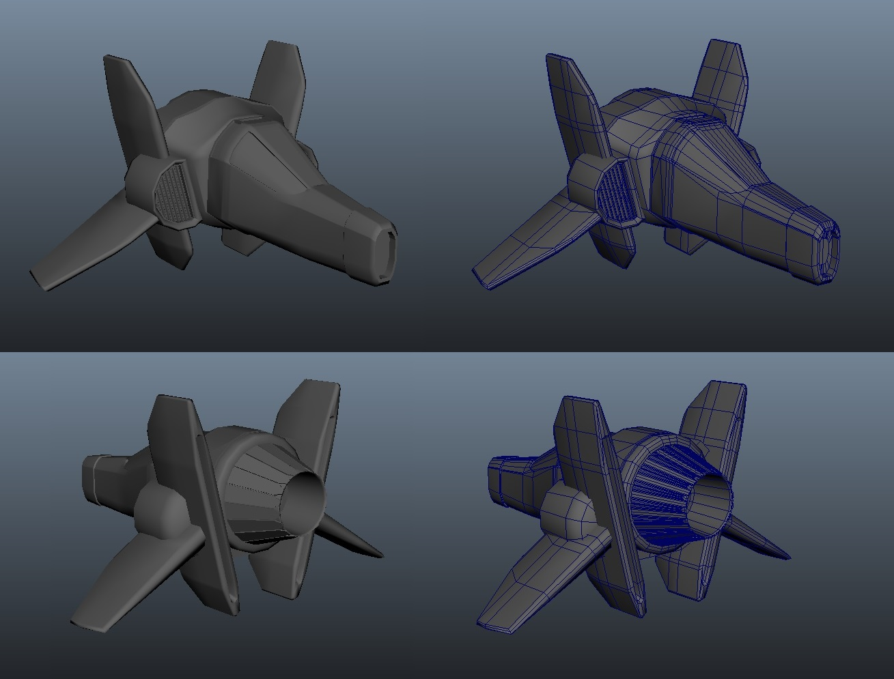
Day 3
Day 3 was Monday of the 2nd week, we all had a pretty good idea of what the game was and how we were going to make it due to frequent group and leader scrums and assigning group members tasks on Trello. Day 3’s priorities were:
1: Level Design Layout
2: Moving art assets into the code-build and assembling levels in-engine
3: Player ship paint over
4: Environment assets to populate the level
5: Planet paint-overs

Slide 10
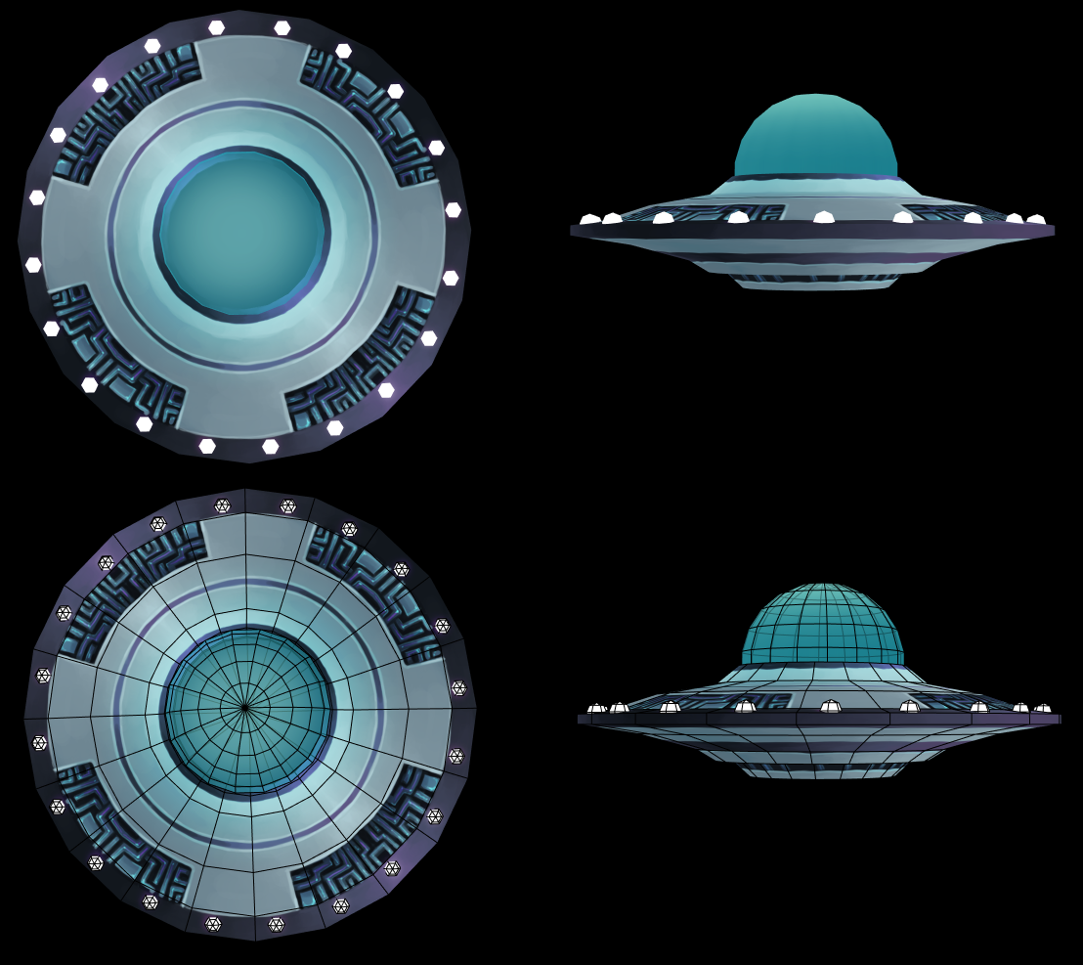
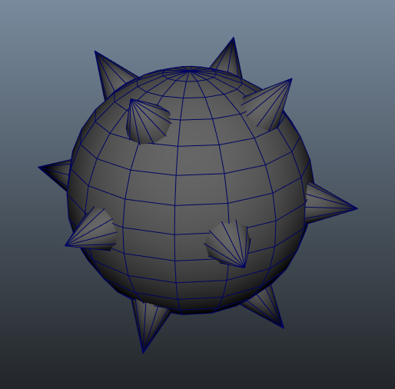
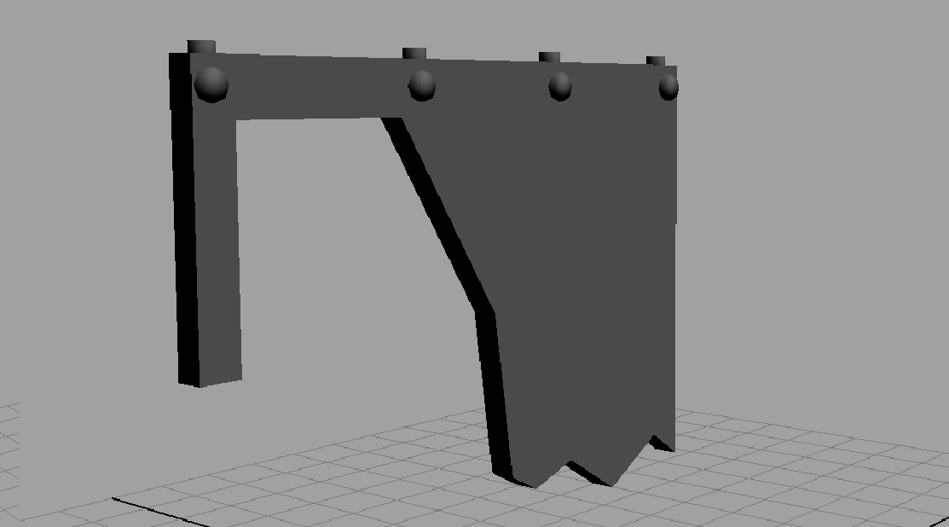

Slide 11
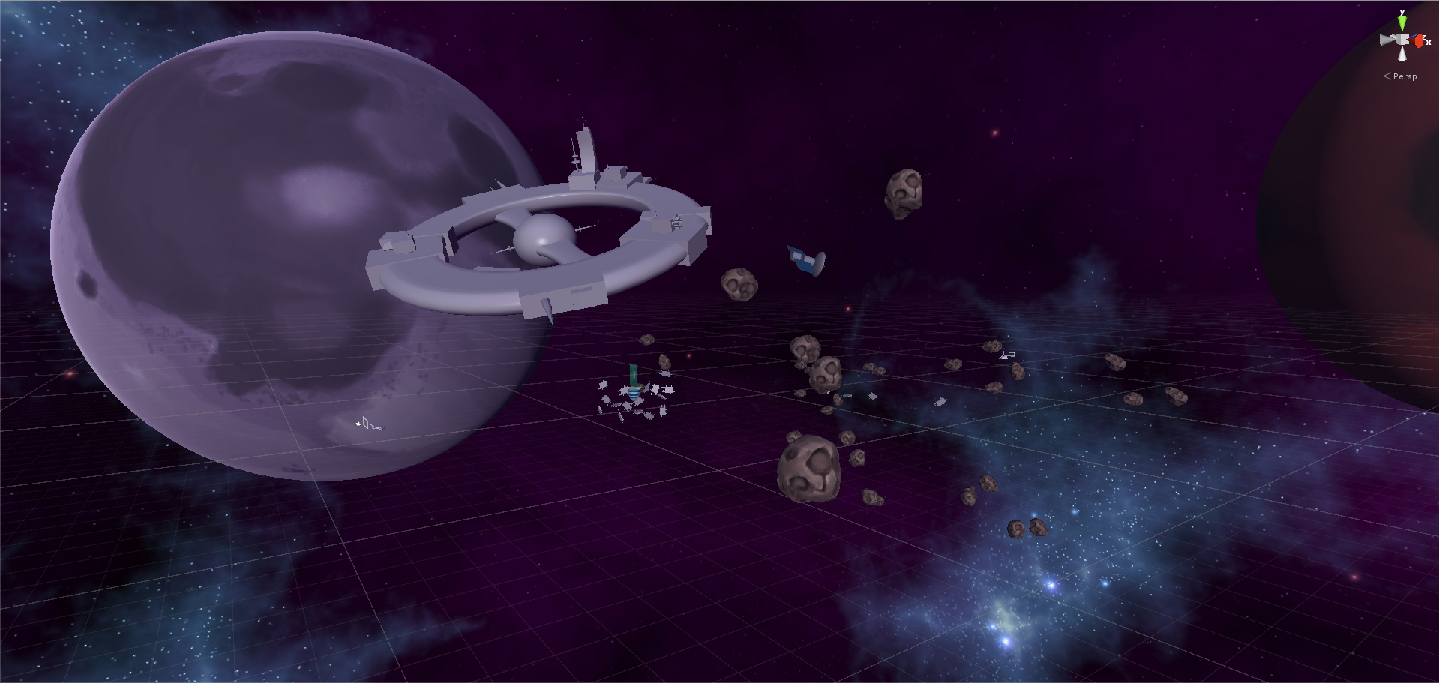

Slide 12
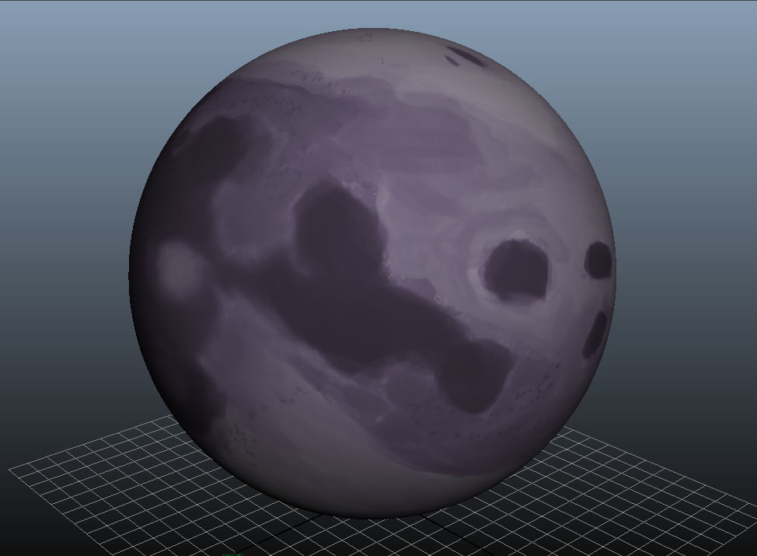
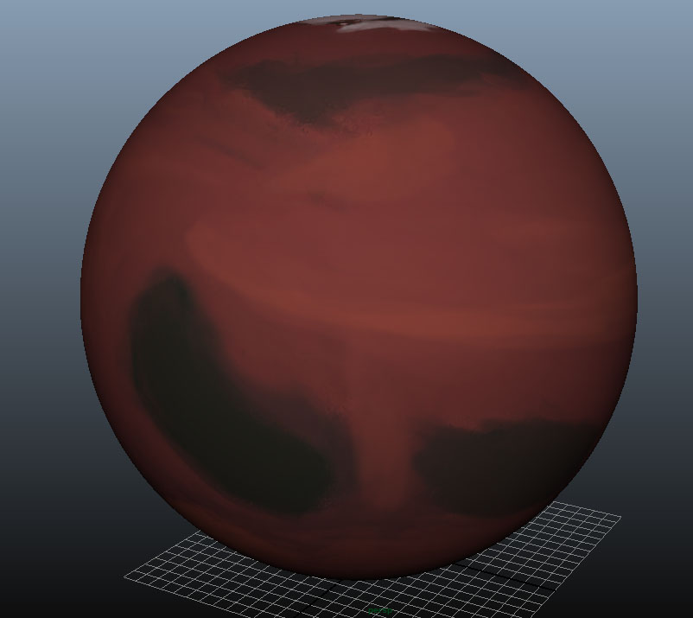
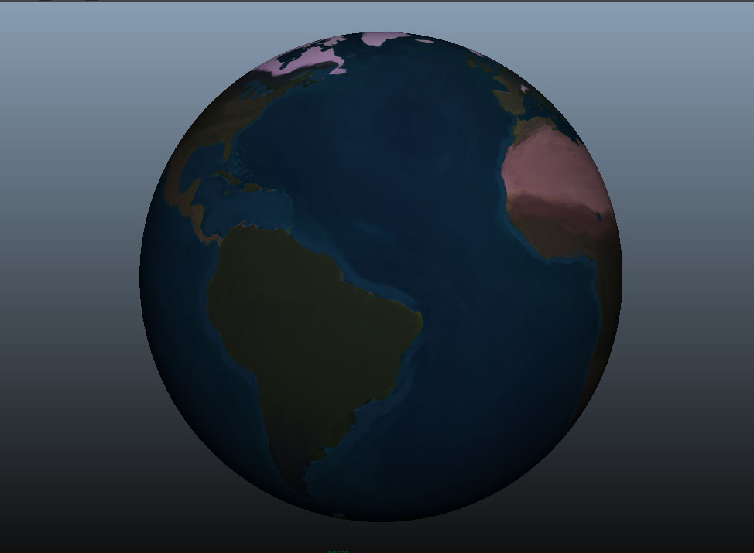
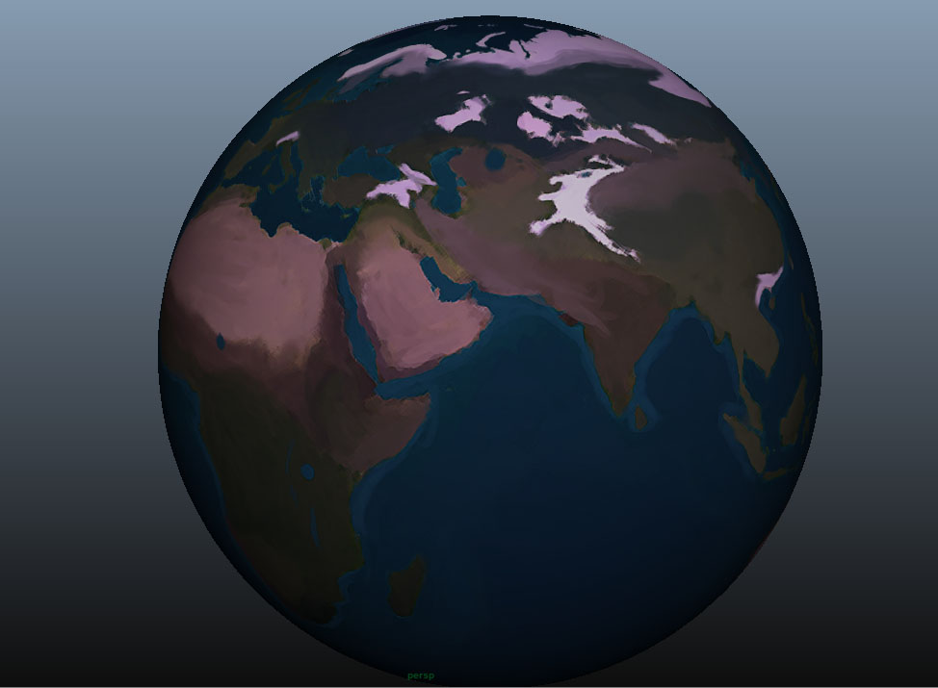

Slide 13
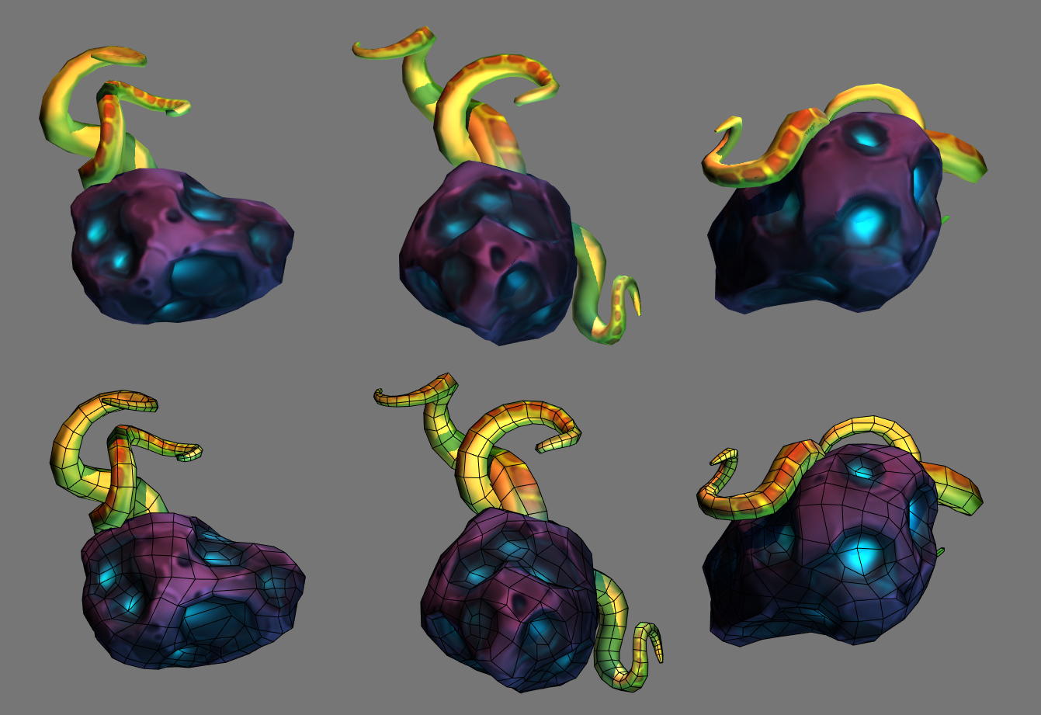

Slide 14
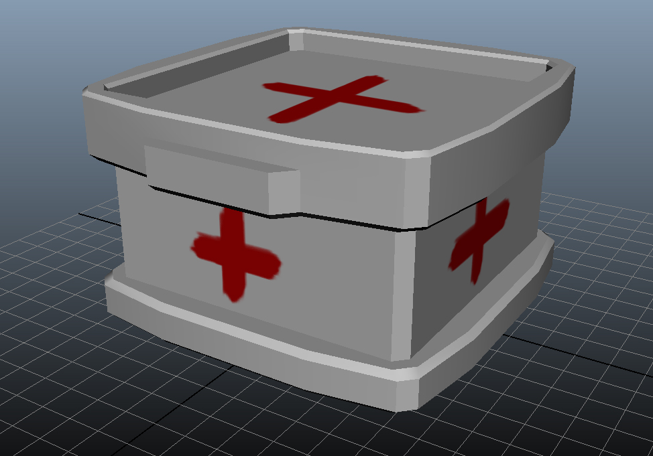
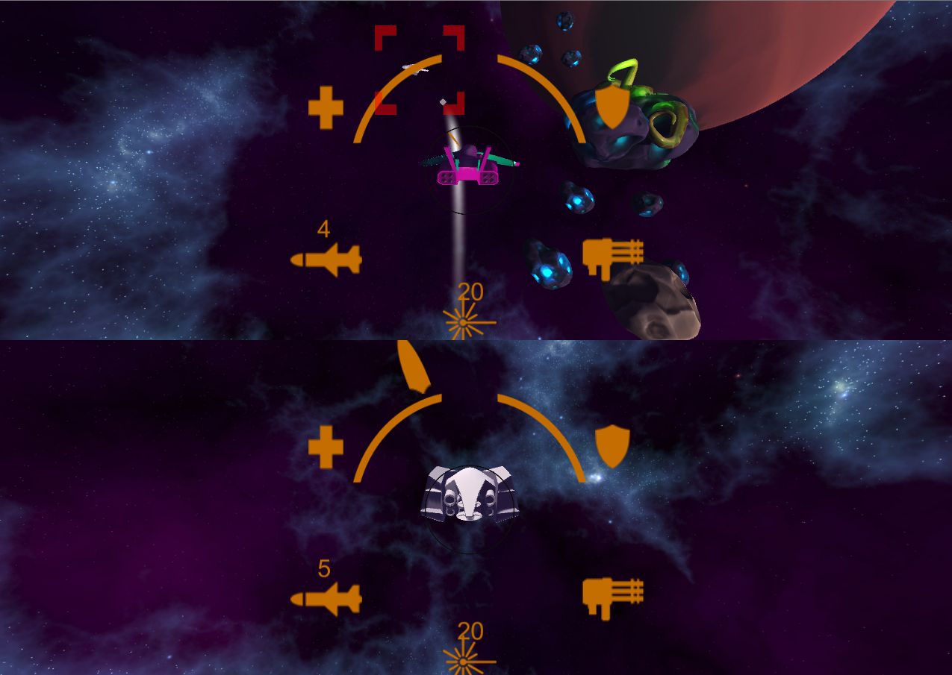
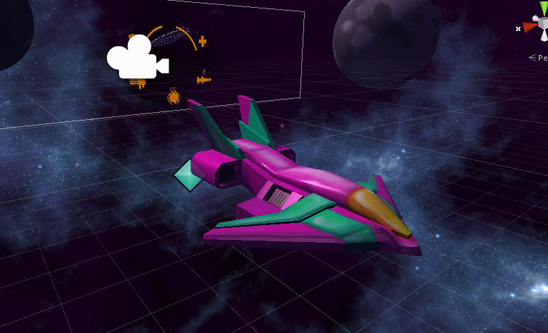
Day 4
Day 4 was Tuesday of the 2nd week, the day was mostly devoted to consolidating all art and code into a build. We have our first playtest that afternoon and got feedback from our team and the lecturers. Day 4’s priorities were:
1:Organising and consolidating script versions
2:Sorting assets and textures into the build
3: Beginning to fill the levels with environmental assets
4: General playtest and feedback collection from working build
5: Texturing assets
6: Begun work on lock-on system for next playtest

Slide 15
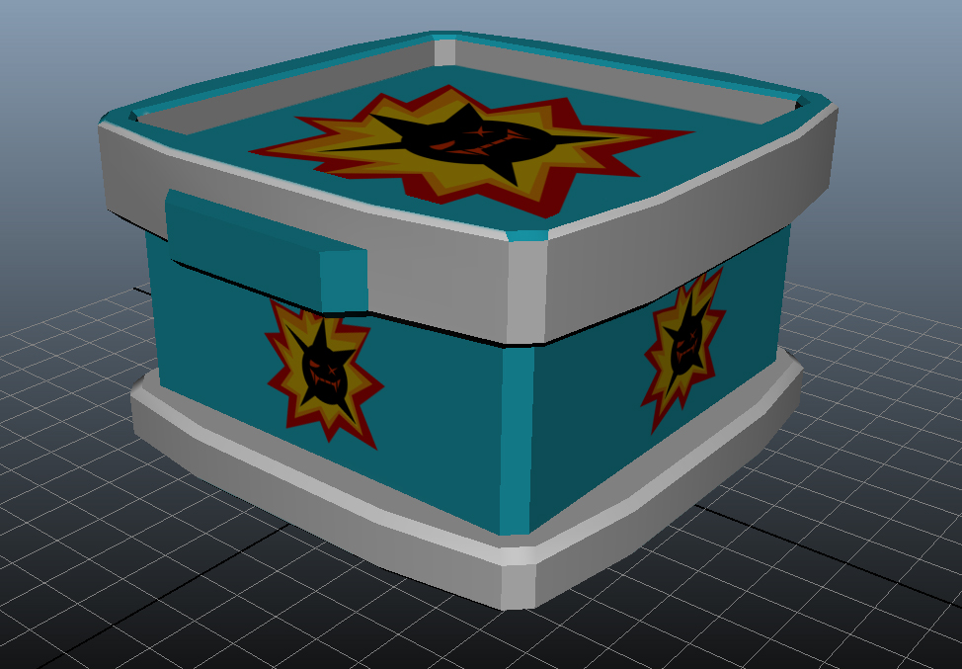
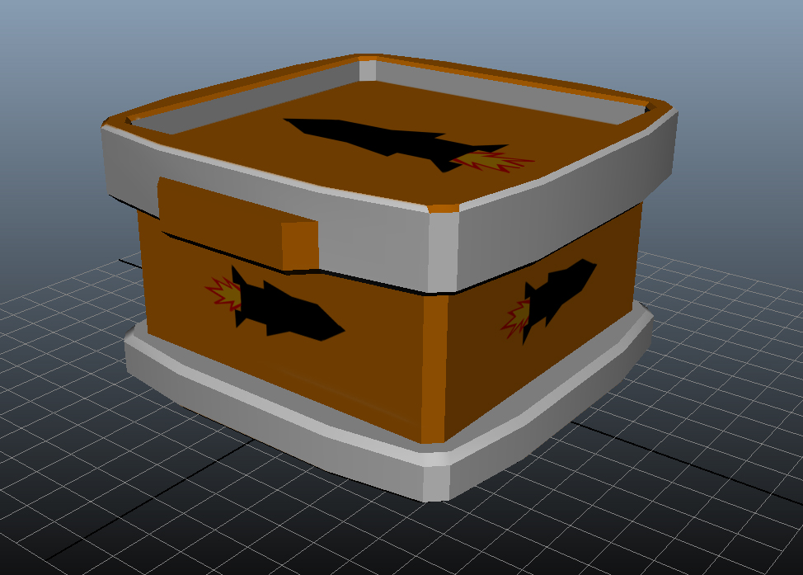

Slide 16
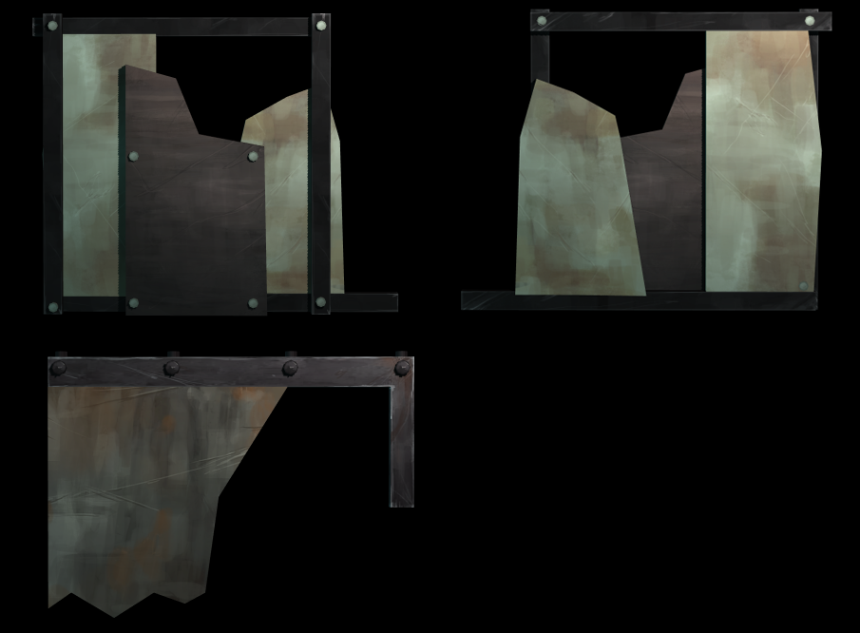
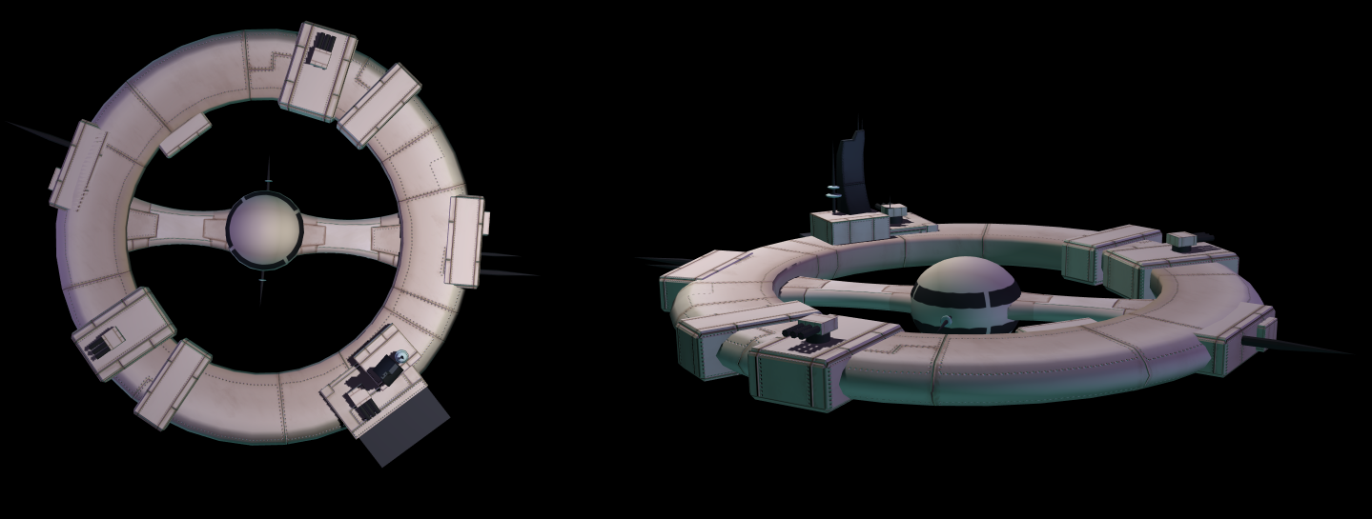

Slide 17
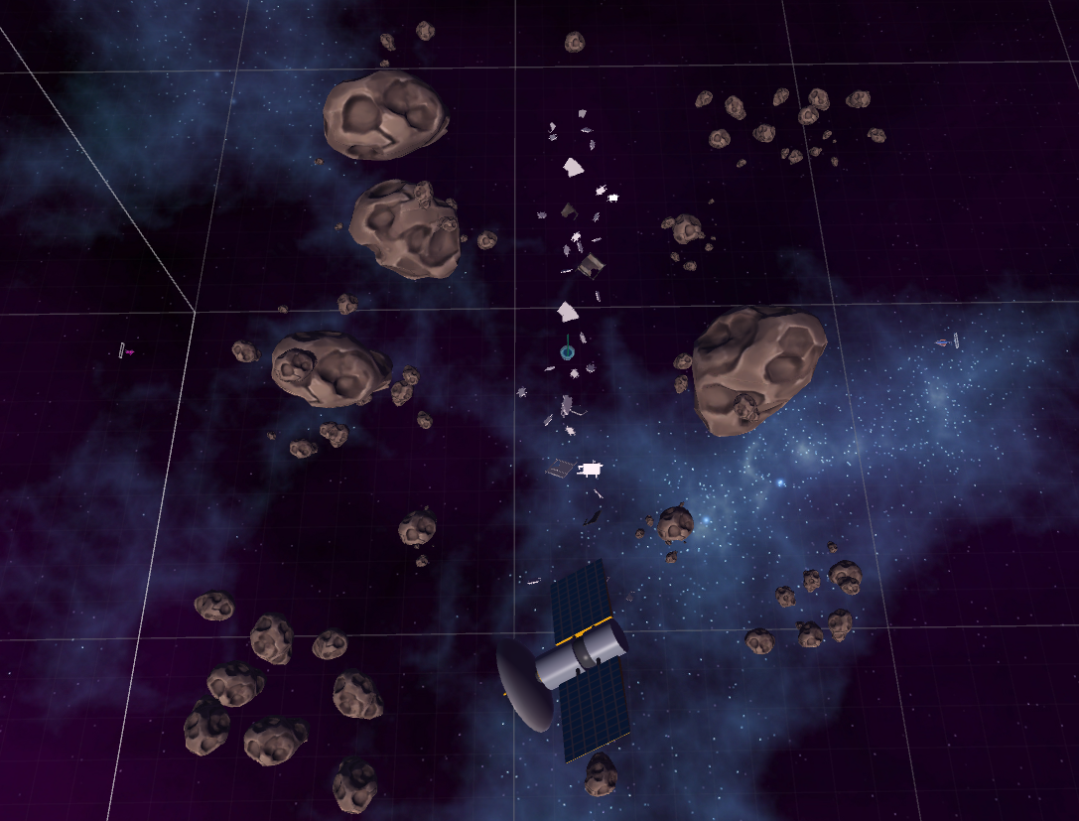
Day 5
Day 5 was Wednesday of the 2nd week, most of the time was spent coding and dealing with the technical side of the game and implementing a system to take the player to the next level after they won
1:Coding the Ion cannon and the EMP
2: Collecting and editing various sound effects
3: Continuing to fill the environment with assets
4: Fixing camera issues when performing maneuvers
5: Coding the variable thrust mechanic
6: Various bug-fixes

Slide 19
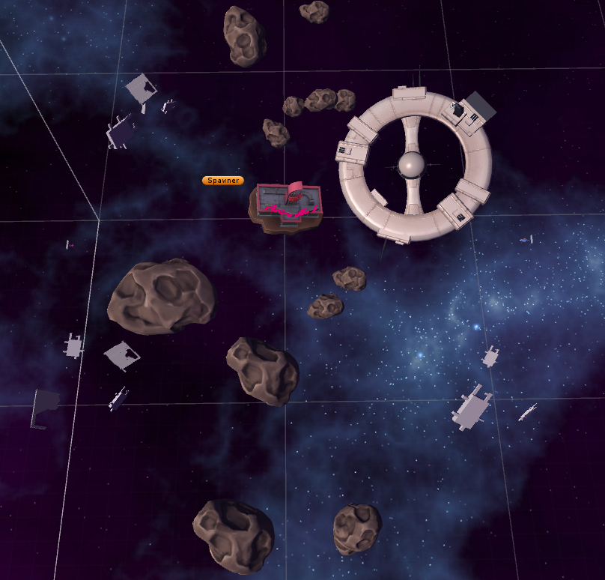
Day 6
Day 5 was Monday of the 3rd week, the focus was on polishing various mechanics as well as bug fixing and getting the sounds implemented in-game
1: Continuing polish and bug fixes
2: Building and laying out of the final two levels
3: Implementing sound effects

