Slide 1
Dwarf fortress
By Brandon Pollastri

Slide 2
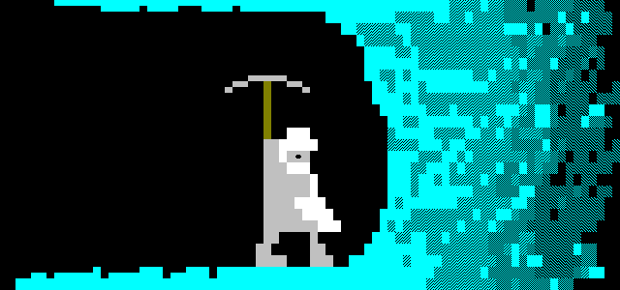
Basic Information
“Dwarf fortress” is a 2D game, text user interface
Known for its complexity and difficulty
Released on 2006 8 of August
Created for all ages down to people above 10 years old
The game is the spiritual successor of “Slaves to Armok: God of blood”
Created by 12 Bay studio.
Economic and strategy gameplay
Fortress mode, adventurer mode
works on Window Linux, Mac OS X.
Free to download
Updated regularly

Slide 3
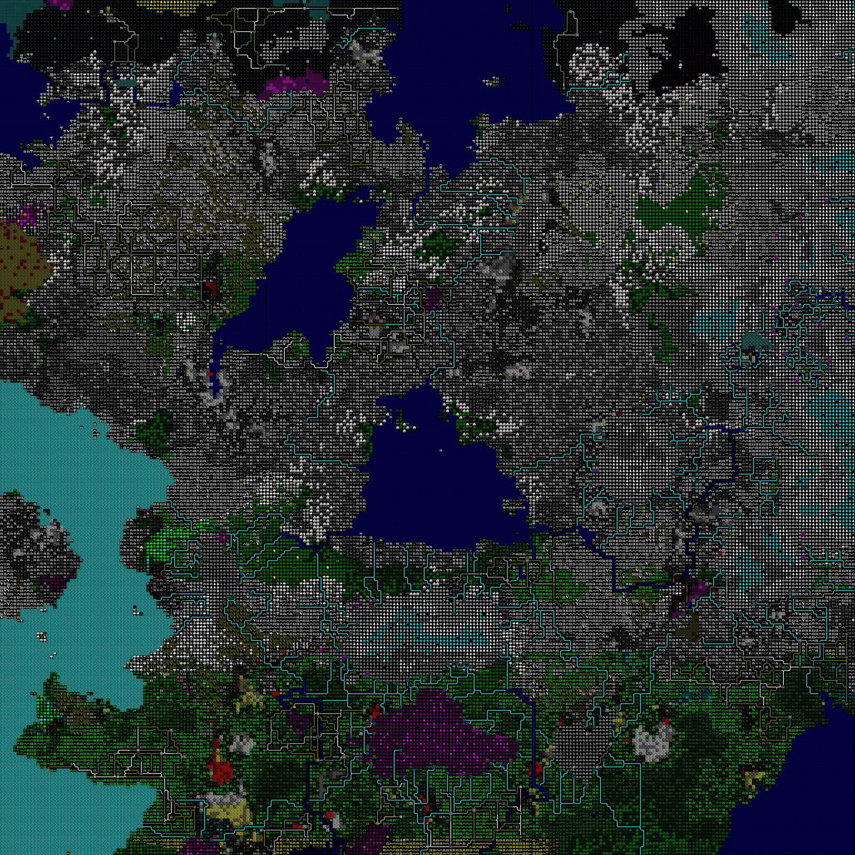
The world
offers the ability to create the world itself.
Such as size of the landscape,
The length of time events pass
The size of the civilizations
Level of savagery in the wilderness.
Bird eye view
Multi layered environment
Reach the Centre of the earth.
Discover caves, lairs, caverns or hell
Near endless landscape
A text made World!

Slide 4
society AND DWARVES
Create a fortress of your own design
See wide variety of characters and creatures
Make Friends or foes, allies or enemy's
Complex personality and behaviors
Fears and joys
Food and luxury
Dwarves with Professions and jobs
Nobles and peasants
Make trades and deals
Have pets or tame beasts
Have prisons and deliver justice, or injustice.
Beware dwarves love beer.

Slide 5
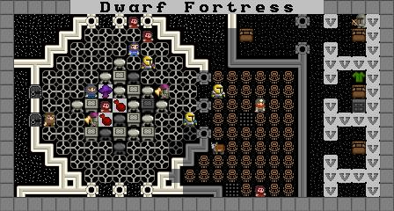
Skills and appearance
disfigurement or decapitation, Mental trauma
Lost limbs, eyes, fingers, toe nails
Scars
Insanity
Emotional traumatized
Etc.
Professional skill branches
Farming
Building
Military
Etc.
Natural Skill Branches
Swimming
Running
Lying
Biting
Etc.
Dinner at the Fortress

Slide 6
Adventure Time!
Start Adventure mode, Make an adventurer
Pick the specifics
Race
Gender
Skills
Location
Find your old fortress, Inhabited by it evil conquers
Build a merry party to adventure with
Face Horrifying disfigurement and decapitations
Take on quests and face many dangers
Explore the whole world, discover lost treasures
Become all powerful or meet a fatal end
Have fun by dicing and slicing

Slide 7
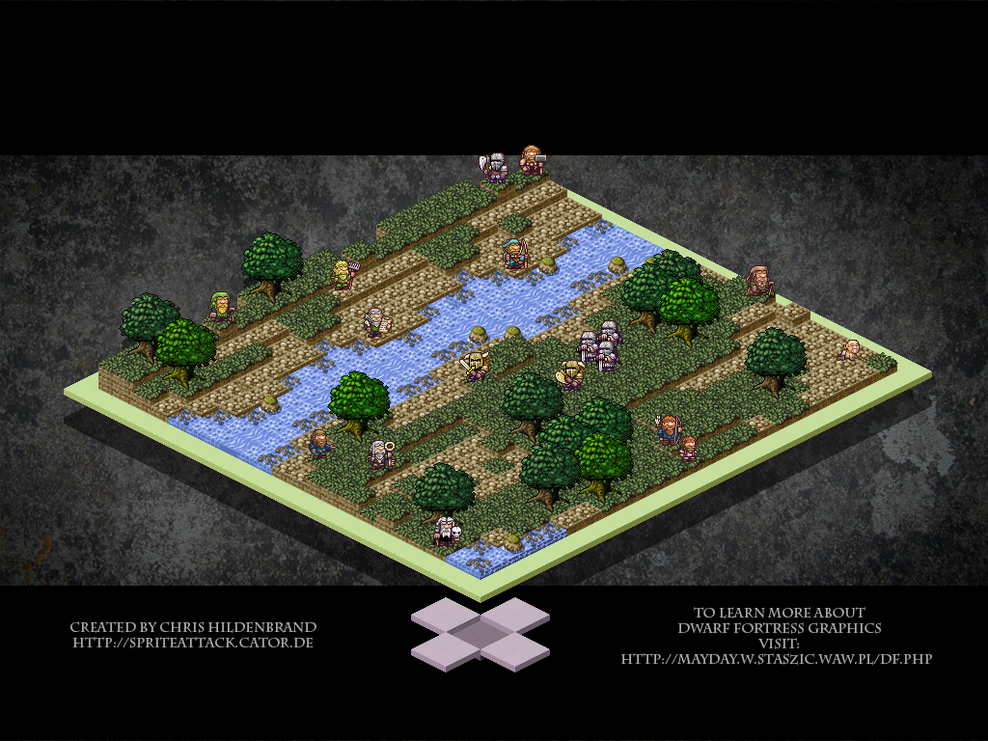
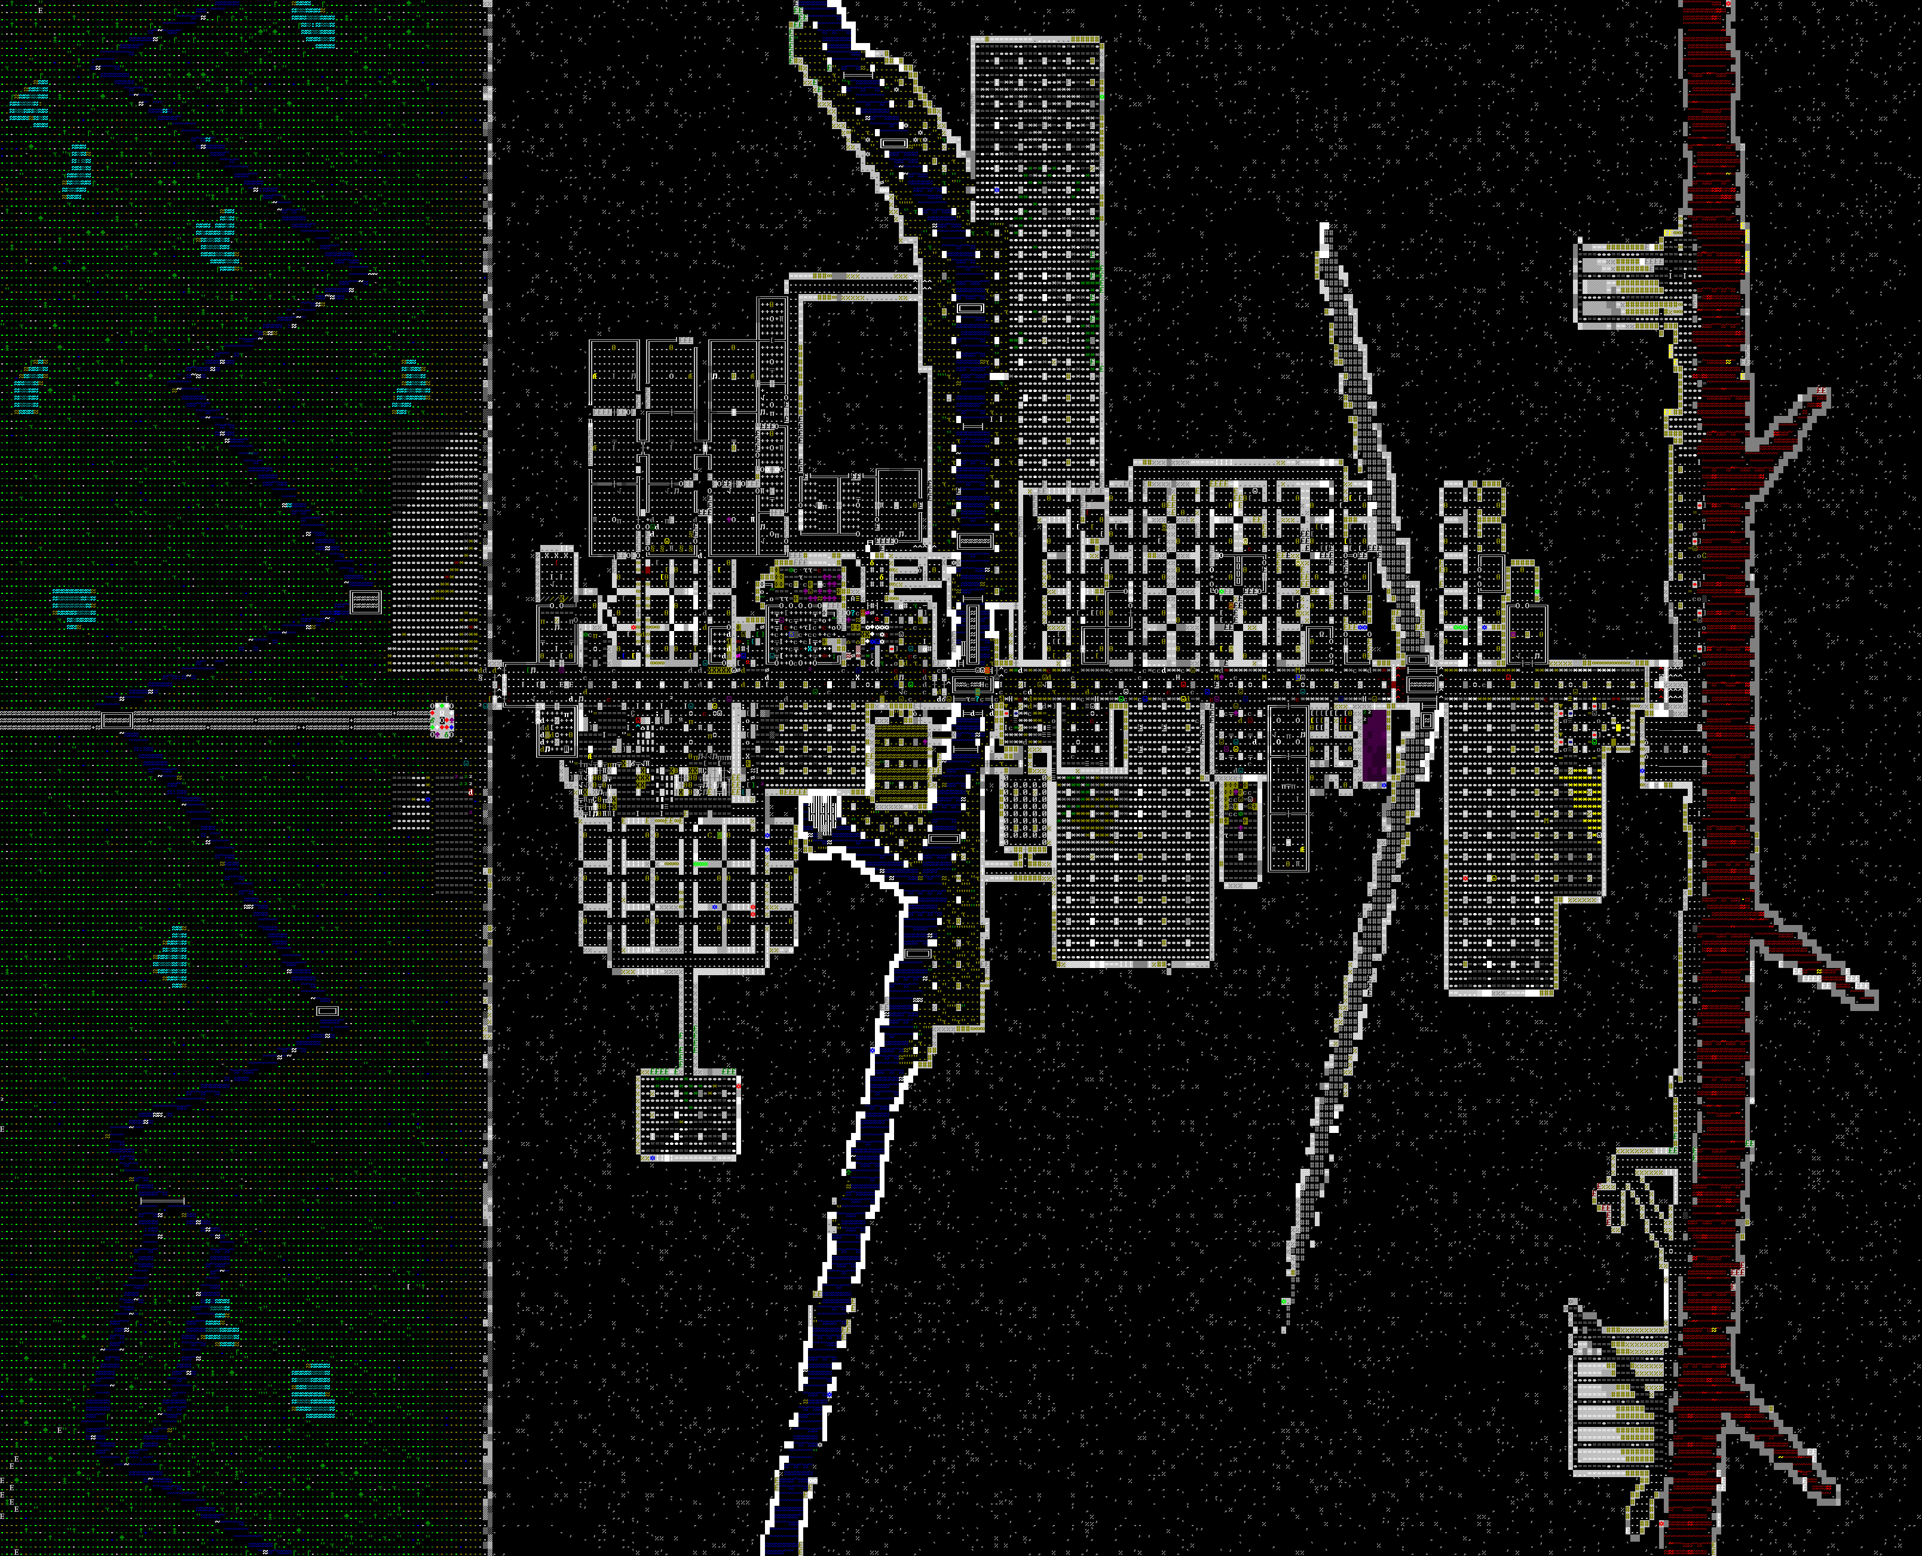
source OF information
http://www.bay12games.com/dwarves/
http://en.wikipedia.org/wiki/Dwarf_Fortress
http://afteractionreporter.com
http://dftutorial.wordpress.com/
http://pressxordie.com/
Upgrade With a tile mod!
Hate the visual appearance?
Then

